Slide 1

Dynamic Time Warping For Gait Analysis
TEAM 11
SBEG 207
SUPVISED BY :
DR. EMAN

Slide 2

Summary
Introduction
Problem Definition
Why DP
How the Algorithm Works
Results
Challenges
Conclusion

Slide 3

Introduction

Slide 4

Gait Analysis in Rehabilitation
Gait analysis is a key tool in physical therapy and rehabilitation
Used to assess recovery after stroke, injury, or neurological disorders
Modern systems rely on sensor-based time-series data (accelerometers, IMUs, motion capture, cameras)
A major challenge is comparing patient gait to a healthy reference
HOWEVER, COMPARING GAIT SIGNALS IS NOT STRAIGHTFORWARD, ESPECIALLY WHEN PATIENTS WALK AT DIFFERENT SPEEDS OR THE SIGNAL HAS NOISE.

Slide 5

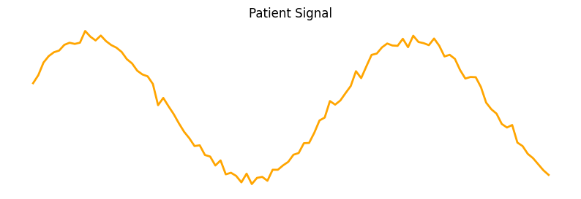
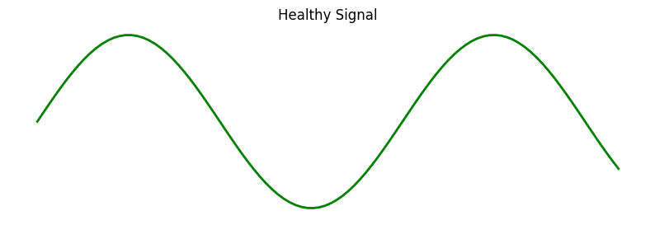
Problem Definition
Stroke patients often walk slower and irregularly
Clinicians want to compare patient gait to a healthy reference
Direct comparison fails due to speed differences
PROBLEM
healthy signal but merely walking slower/noise
healthy signal

Slide 6
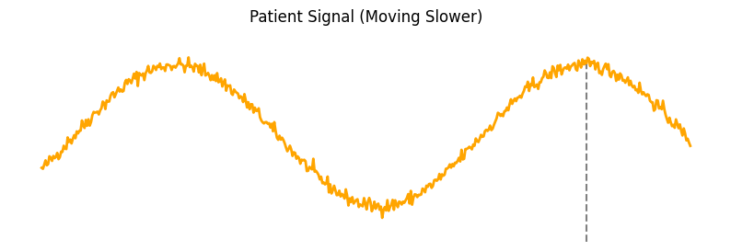
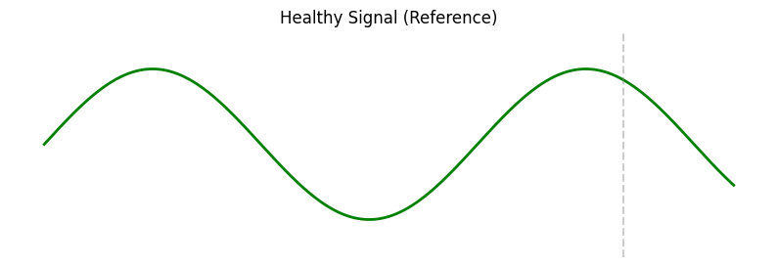
Why Simple Distance Fails
Euclidean distance assumes point-to-point alignment
Speed differences → high error even if shapes match

Slide 7

Why DP?

Slide 8
Efficiency
Why DP is appropriate
Optimization
Reusability
OUR METHODOLOGY
We need the optimal non-linear alignment
Choices depend on previous alignments
Overlapping subproblems → DP is ideal
Scalability
Simplification

Slide 9

How does the Algorithm works?

Slide 10
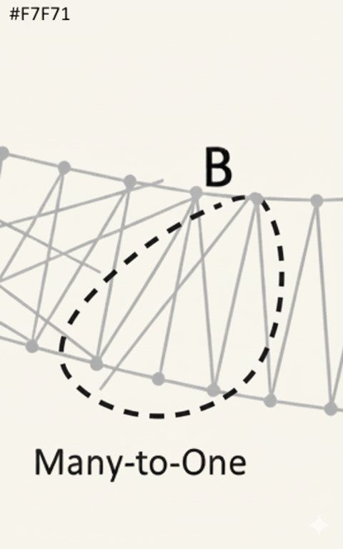
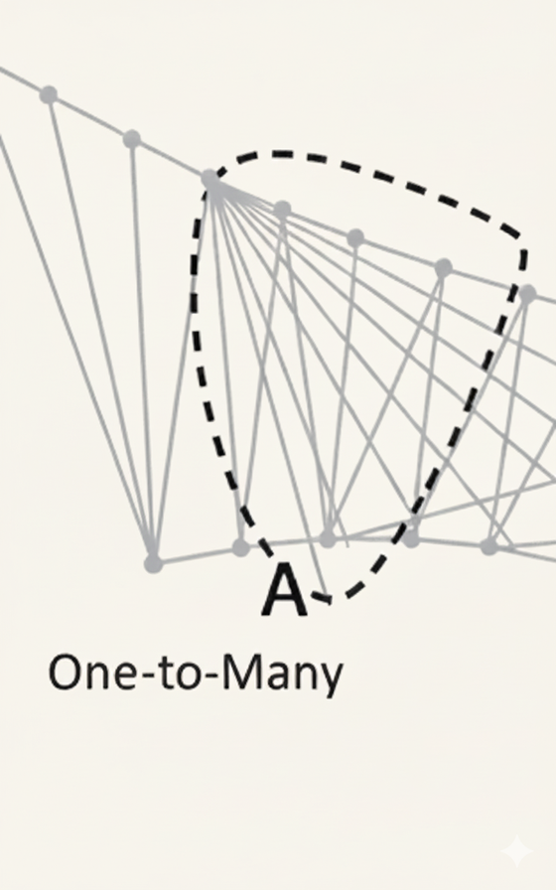
Dynamic Time Warping
ALGORITHM INTUITION
Dynamic Time Warping compares two time-series by allowing non-linear alignment
Instead of matching point A in healthy to point A in patient, DTW allows flexible matching:
Repeats points
Skips points
Stretches or compresses time
The goal is to find the minimum-cost alignment path between two sequences

Slide 11


Input and Output Definition
INPUT
OUTPUT
DISTANCE METRIC
Inputs:
Healthy Signal = [h₁, h₂, ..., hₙ]
Patient Signal = [p₁, p₂, ..., pₘ]
Output:
Minimum alignment cost (similarity score)
Optimal warping path
Distance Metric:

Slide 12

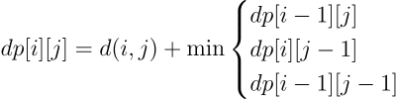
DP Formulation
Subproblem
= minimum cost to align
first healthy points with first patient points
Recurrence Relation:
Base Cases
First row/column = ∞ (or large number)

Slide 13
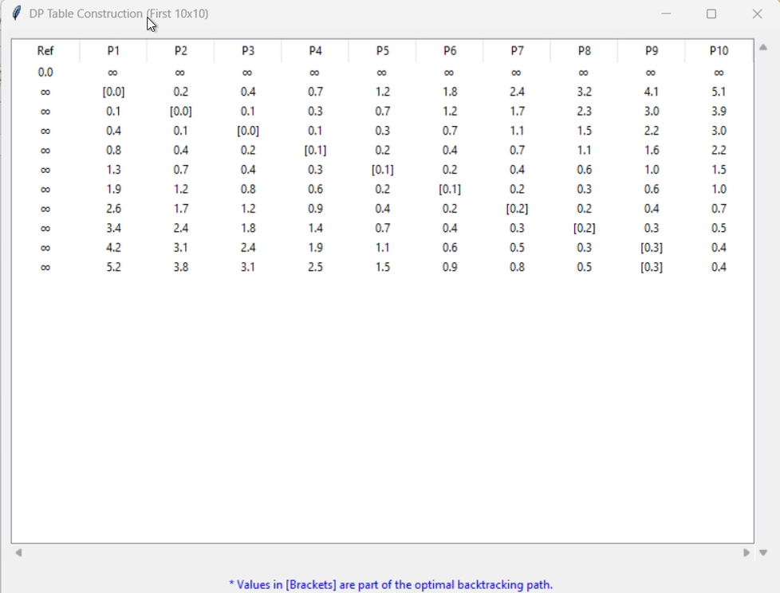
DP Table Construction & Backtracking
CASE1: HEALTHY MACTH
Values in brackets are part of the optimal backtracking path

Slide 14
Complexity
Time Complexity:
Space Complexity:
CAN BE REDUCED TO O(MIN(N, M)) IF ONLY COST IS NEEDED

Slide 15

Results

Slide 16
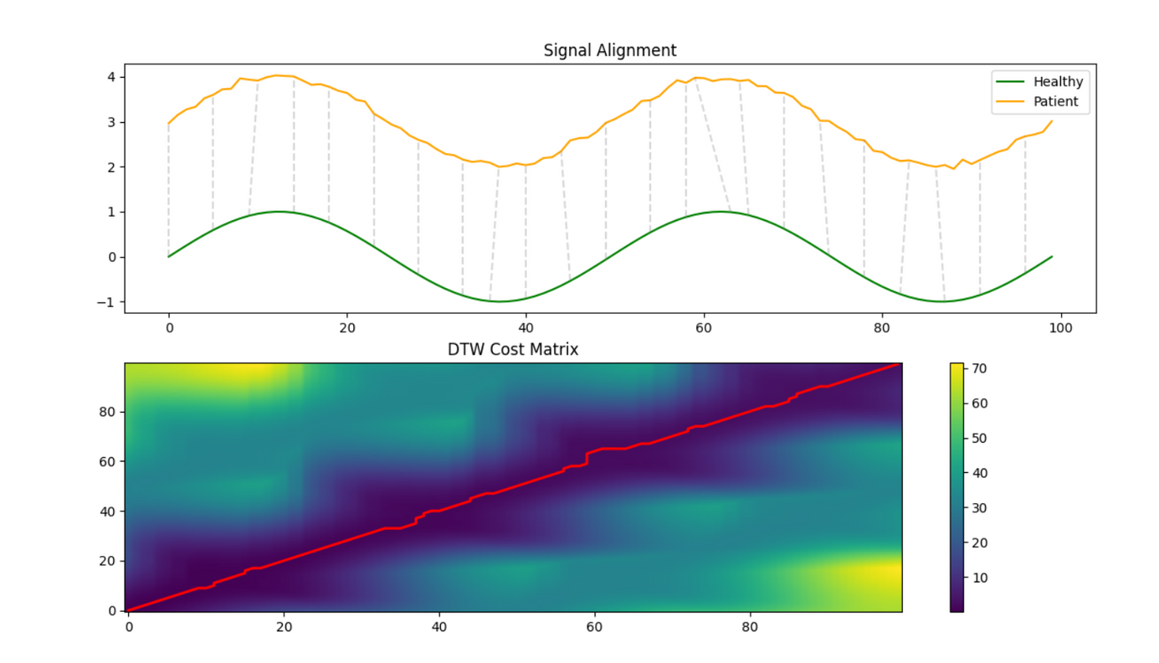

Experimental Results
CASE1: HEALTHY MACTH

Slide 17
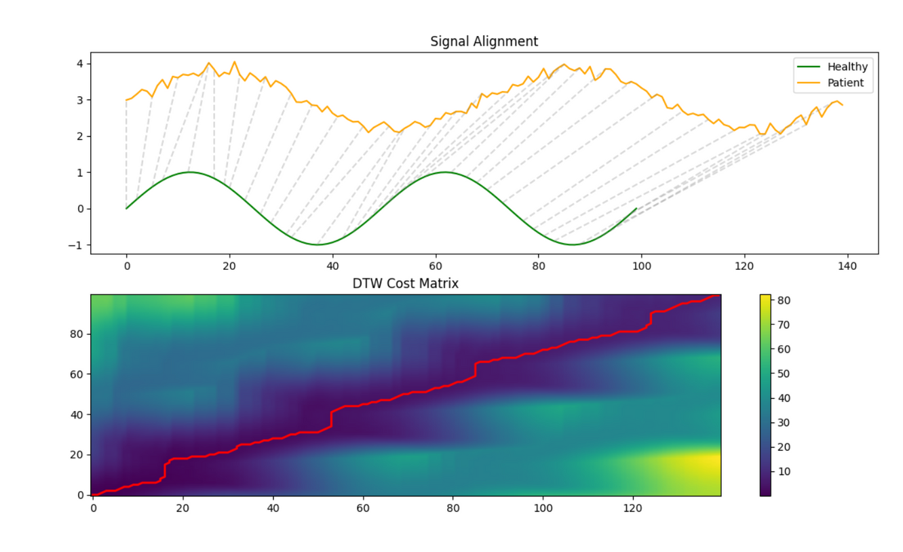

Experimental Results
CASE2: SLOW PATIENT

Slide 18
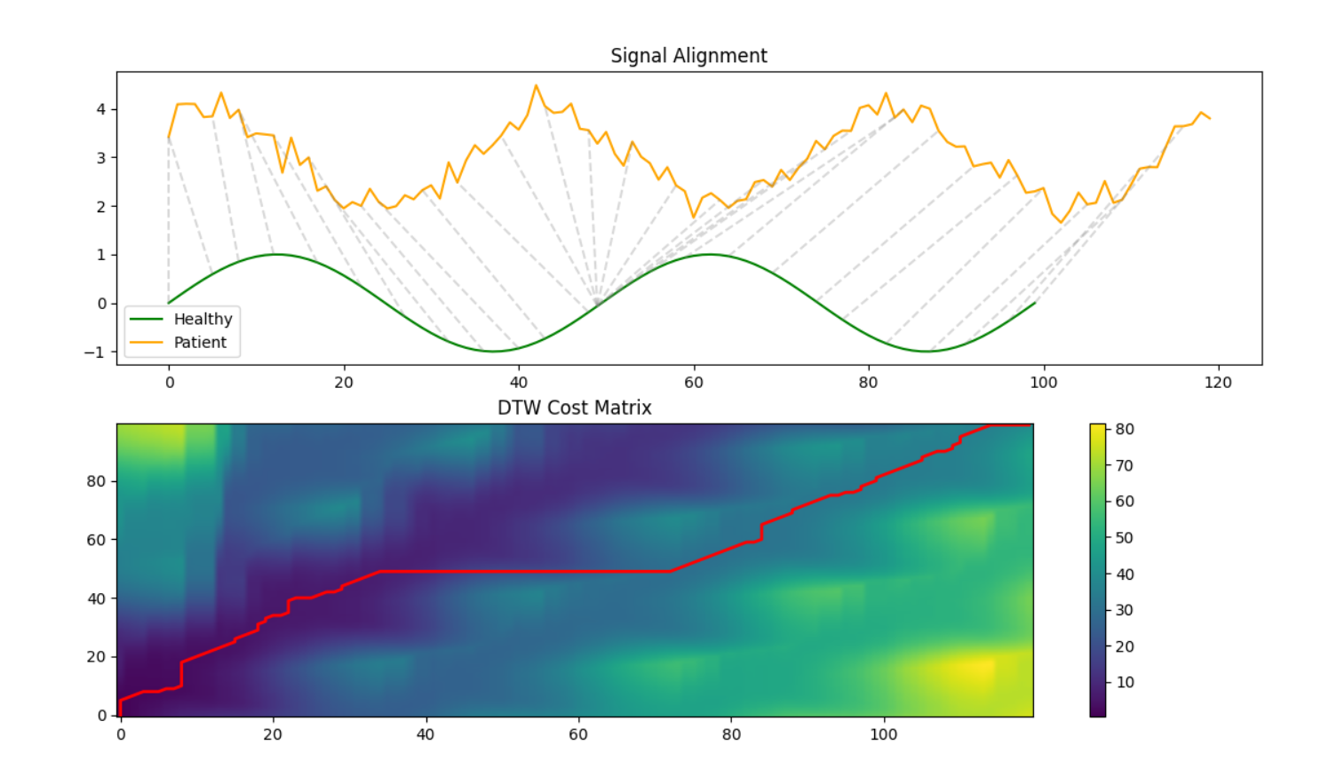

Experimental Results
CASE3: SEVERE ASYMETERY

Slide 19
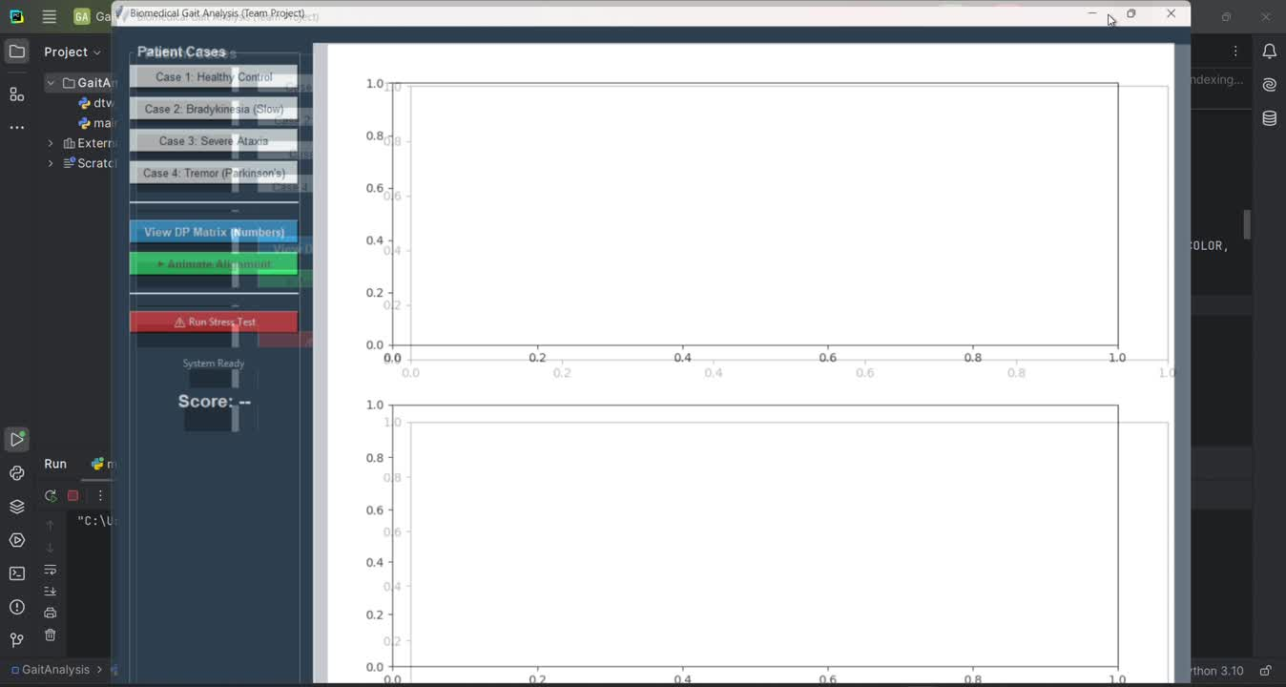
Live Demo

Slide 20

Challenges

Slide 21
High Sensitivity to Noise (The "Outlier" Trap)
Accelerometers are incredibly noisy. A simple bump of the sensor or a loose strap creates a "spike" in the data.
The "Endpoint" Constraint
Standard DTW assumes the sequences start and end at the same phase (e.g., both start at a heel strike).
3. Computational Complexity
While fine for one stride, if you want to analyze a 10-minute walk at 100Hz, you have 60,000 points. A 60k x 60k matrix will crash a standard computer's memory.

Slide 22



Conclusion
We presented a Dynamic Programming–based system for gait analysis in rehabilitation.
Dynamic Time Warping enables accurate comparison of gait patterns despite walking speed variations.
The DP formulation guarantees an optimal non-linear alignment between patient and healthy signals.
Experimental results show that DTW produces low similarity scores for biomechanically similar gaits, even when temporal distortions exist.
This approach demonstrates how algorithmic techniques can solve real-world biomedical signal analysis problems.

Slide 23
References
[1] F. Massaad, T. M. Lejeune, and C. Detrembleur, “The up and down bobbing of human walking: A compromise between muscle work and efficiency,” Journal of Physiology, vol. 582, no. 2, pp. 789–799, Jul. 2020, doi: 10.1113/jphysiol.2020.127969.
[2] H. S. Lee, “Application of dynamic time warping algorithm for pattern similarity of gait,” Journal of Exercise Rehabilitation, vol. 15, no. 4, pp. 526–530, 2019, doi: 10.12965/jer.1938384.192.
[3] W. Pirker and R. Katzenschlager, “Gait disorders in adults and the elderly: A clinical guide,” Wiener Klinische Wochenschrift, vol. 129, no. 3–4. Springer-Verlag Wien, pp. 81–95, Feb. 01, 2017. doi: 10.1007/s00508-016-1096-4.

Slide 24

Thanks for your attention!

